Slide 1
Module Title: Geriatrics Anesthesia Module Code: AnstM-5341 Module ECTS: 5 ECTS Module Duration: 20 Weeks
Instructor: Mr. Hirbo Samuel

Slide 2
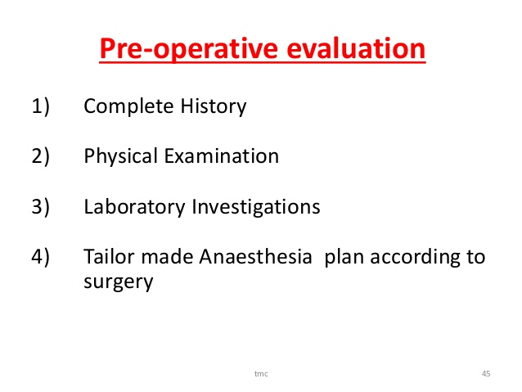
Pre-operative evaluation

Slide 3
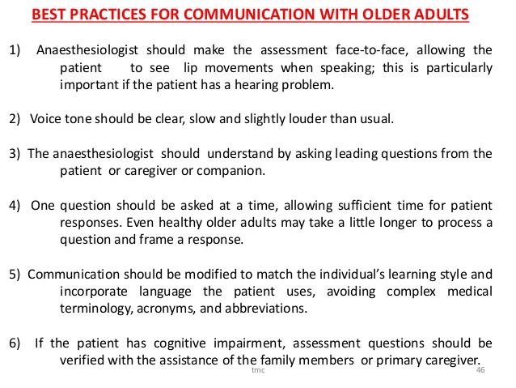
Communication with older adults

Slide 4
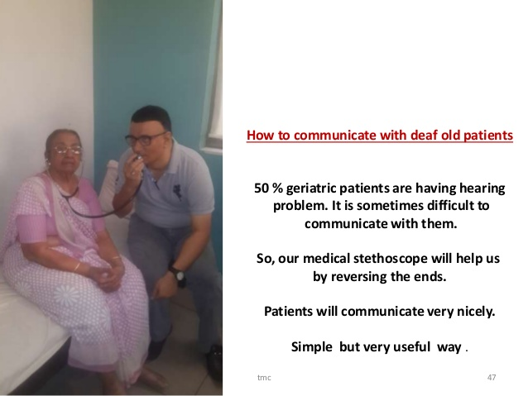
Continued…

Slide 5
History
Prior to taking a history,
a mini mental state score is very useful primarily to assess reliability of information
MMSE.docx
it might prove very useful in the postoperative period.
Collateral history may be important via relatives, carers, nurses.
Old notes are a very useful source of information, especially old anaesthetic charts.
Notes:
The Mini Mental State Examination (MMSE) is a tool that can be used to systematically and thoroughly assess mental status. It is an 11-question measure that tests five areas of cognitive function: orientation, registration, attention and calculation, recall, and language. The maximum score is 30. A score of 23 or lower is indicative of cognitive impairment. The MMSE takes only 5-10 minutes to administer and is therefore practical to use repeatedly and routinely.

Slide 6
Specific points in the history in addition to a full normal preoperative assessment include:
Background to admission.
Co-existing medical problems.
Gastro-oesophageal reflux disease (GORD) and dentition.
Medications
A detailed social appraisal to assess the level of home support may allow day surgery or earlier involvement of social services prior to discharge.
Notes:
Background to admission. For example, it is especially relevant to ascertain whether the “fall” leading to a fractured neck of femur, was purely mechanical or whether it was a syncopal episode for example.
Co-existing medical problems. The potential list is very long and includes ischaemic heart disease, hypertension, COPD, stroke, arthritis, diabetes, dementia, Parkinson’s, malnutrition, polypharmacy and sensory impairment (visual/hearing loss common).
Gastro-oesophageal reflux disease (GORD) and dentition. The elderly demonstrate slower gastric emptying, deterioration in parietal cell function, a greater incidence of GORD, pharyngeal pouch and hiatus herniae.
Medications- including dose, frequency, when they were started, and any recent changes. It is often difficult to ascertain what is taken especially in acute admissions and drugs maybe inadvertently stopped. Long-term medications should be continued. Do not forget alcohol and cigarettes.
Pay particular attention to steroids, beta-blockers, ACE inhibitors, diuretics, insulin or hypoglycaemic agents and anticoagulants.
A detailed social appraisal to assess the level of home support may allow day surgery or earlier involvement of social services prior to discharge.
Also assess premorbid functional ability including activities of daily living and exercise tolerance as a means of risk stratification.

Slide 7
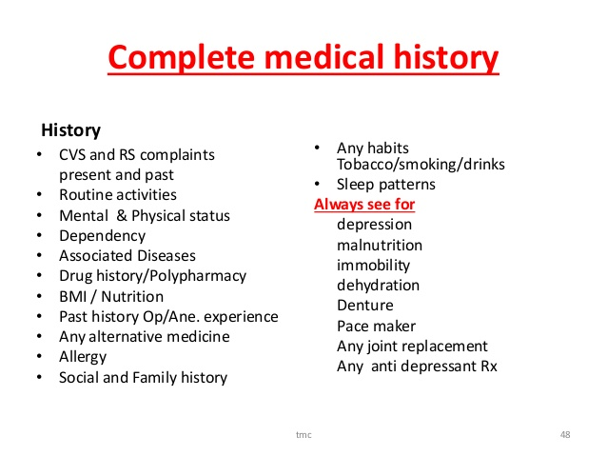

Slide 8
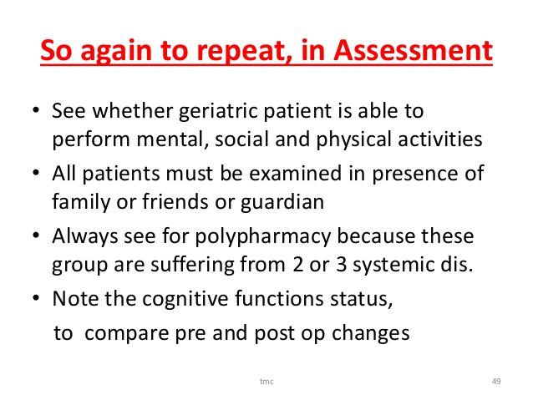

Slide 9
Physical Examination
Following introduction, full exposure whilst ensuring warmth, comfort, and dignity, allows a full complete, clinical examination.
Documentation of blood pressure allows appropriate intraoperative management of hypotension to maintain organ autoregulation perioperatively.
Fluid balance, weight, and nutrition are all important in the assessment.

Slide 10
Bowel prep or fractures may need fluid preoperatively.
Unrecognized pathology might be found, and be highly relevant, such as the systolic murmur of aortic stenosis.
If possible, walk the ward or stairs with the patient to assess “real-time” exercise tolerance.

Slide 11
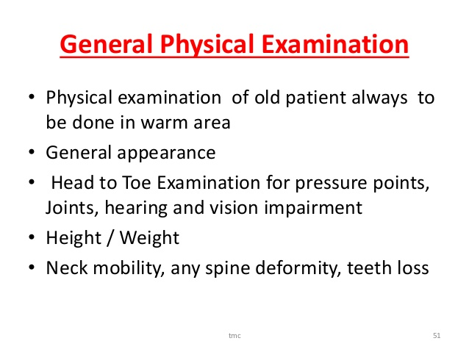
continued…

Slide 12
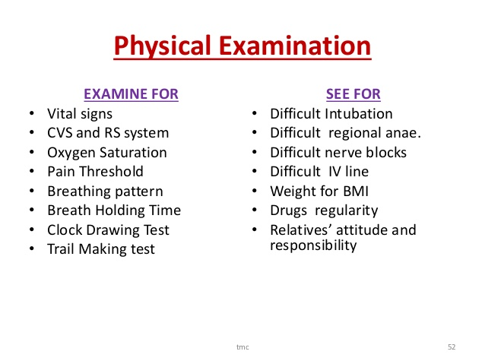
Continued.

Slide 13
Investigation
Given the high incidence of co-morbidities, an absolute minimum of ECG, full blood count, urea and electrolytes, and blood sugar are required.
Otherwise, investigate as clinically indicated.
Age is not a barrier in itself to more “active” tests such as exercise ECG and cardiopulmonary exercise testing.

Slide 14
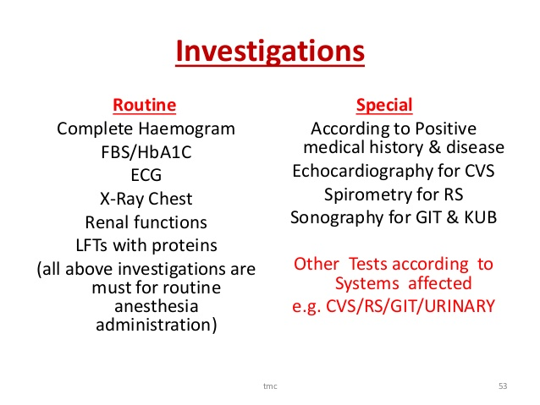
Continued…

Slide 15
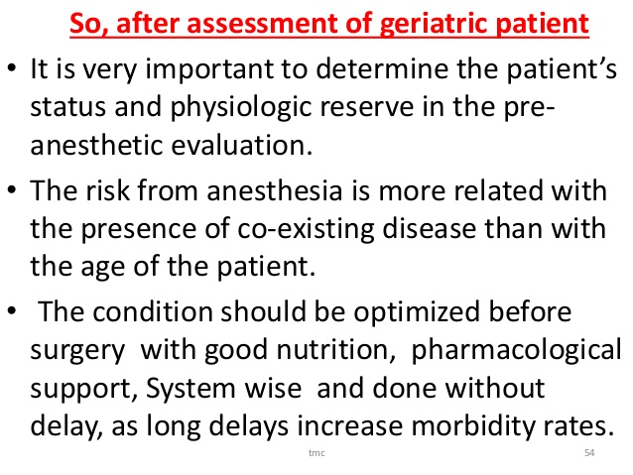
Optimizing geriatric patients

Slide 16
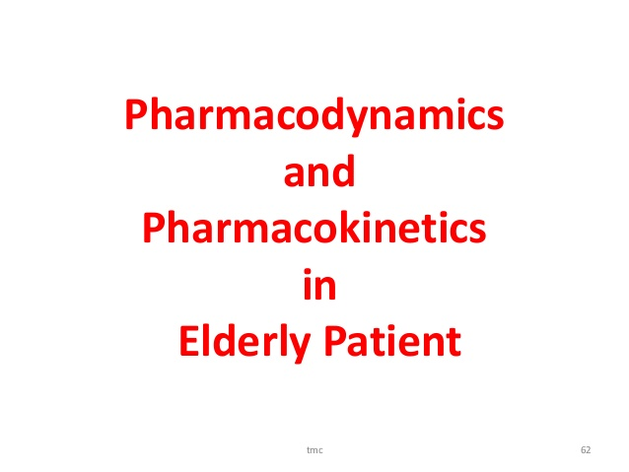

Slide 17
continued….
Aging produces both pharmacokinetic (the relationship between drug dose and plasma concentration) and
pharmacodynamic (the relationship between plasma concentration and clinical effect) changes.
Notes:
Disease-related changes and wide variations among individuals in similar populations prevent generalizations.
The principal pharmacodynamic change associated with aging is a reduced anesthetic requirement, represented by a MAC.

Slide 18
Continued…
A progressive decrease in muscle mass and increase in body fat (particularly in older women) results in decreased total body water.
The reduced volume of distribution for water-soluble drugs can lead to greater plasma concentrations; conversely,
an increased volume of distribution for lipid-soluble drugs could theoretically reduce their plasma concentration.
Notes:
Any change in volume of distribution sufficient to significantly change concentrations will influence the elimination time.

Slide 19
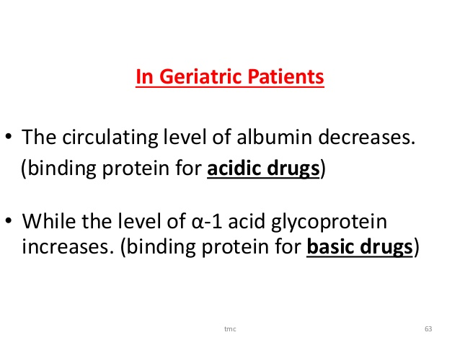
Continued…
Notes:
Distribution and elimination are also affected by altered plasma protein binding. Albumin, which binds acidic drugs (eg, barbiturates, benzodiazepines, opioid agonists), typically decreases with age. α 1 -Acid glycoprotein, which binds basic drugs (eg, local anesthetics), is increased.

Slide 20
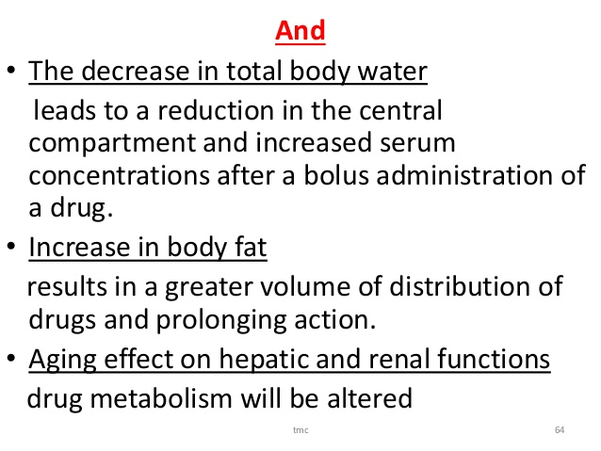
continued….
Notes:
Careful titration of anesthetic agents helps to avoid adverse side effects and unexpected, prolonged duration; short-acting agents, such as propofol, desflurane, remifentanil, and succinylcholine, may be particularly useful in elderly patients. Drugs that are not significantly dependent on hepatic or renal function or blood flow, such as atracurium or cisatracurium, are useful.

Slide 21
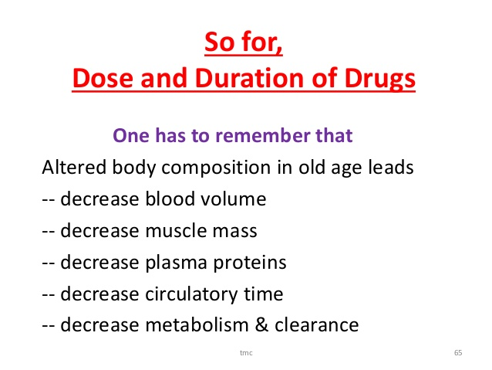
Continued…

Slide 22
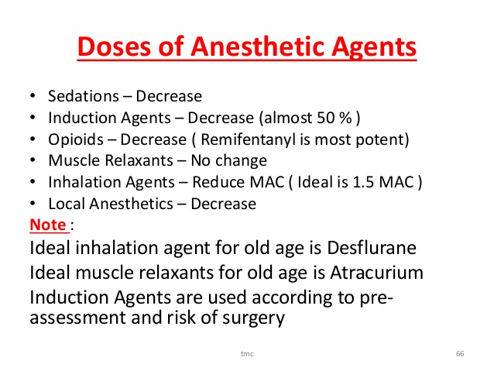
continued….
Notes:
The MAC for inhalational agents is reduced by 4% per decade of age over 40 years. The onset of action is faster if cardiac output is depressed,
whereas it is delayed if there is a significant ventilation/ perfusion abnormality.
Recovery from anesthesia with a volatile anesthetic may be prolonged because of an increased volume of distribution (increased body fat) and decreased pulmonary gas exchange.
Decreased hepatic function is of less importance, even for halothane.
Agents that are rapidly eliminated (eg, desflurane) are good choices for speeding emergence in the elderly patient (oil gas partition coefficient is low ).

Slide 23
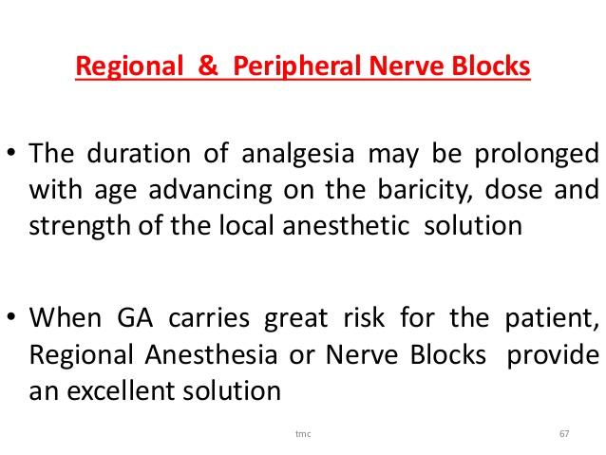
continued…

Slide 24
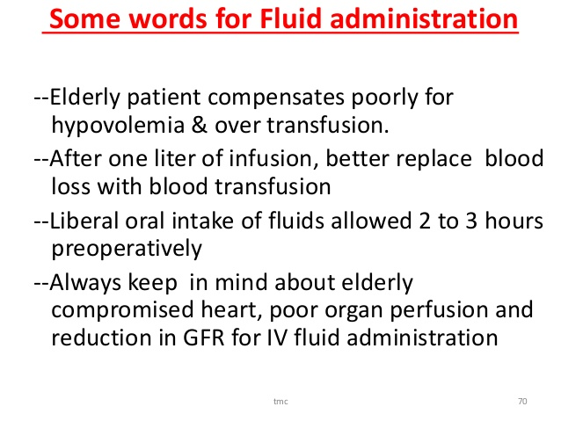
Continued…

Slide 25
week 7
Frailty criteria to assess geriatrics patients vulnerability to disability
Assignment for group 1
Geriatrics patient optimization

Slide 38
Notes:
Agitation, stress, unwarranted mobilization, straining, intramuscular injection, pain and fever can increase hemodynamic stress and predispose to rebleeding.
Nicardipine, labetalol and sedation have been used to control hypertension.

Slide 40
Notes:
Therefore, intravascular volume and electrolyte status should dictate type and quantity of fluids, with a goal to maintain euvolemia and normal electrolyte function.

Slide 41
References
• Millers Anesthesia, 8th Edition
• Clinical anesthesia, Barash 8th Edition
• Morgan and Mikhail’s clinical anaesthesiology 6th edition

